Slide 1
Elasticity and Its Applications

Slide 2
Elasticity
Enables analysis of changes in supply and demand and its impact on the buyers and sellers.
Elasticity, is responsiveness to change in price of a good. It is always measured in percentage terms and the sign is ignored.
Various types of elasticity
Demand elasticities
Price elasticity of demand
Income elasticity of demand
Cross-price elasticity of demand
Supply Elasticity

Slide 3
PRICE ELASTICITY OF DEMAND
The price elasticity of demand: how much the quantity demanded of a good changes due to a change in the price of that good.
In brief, the price elasticity of demand is the percentage change in quantity demanded of a good due to a percentage change in the price of that good.

Slide 4
The Price Elasticity of Demand and Its Determinants
Availability of Close Substitutes
Larger no. of close substitutes higher elasticity
Necessities versus Luxuries: low elasticity for necessities, higher for luxuries
Definition of the Market: Narrow definition of mkt higher elasticity
Time Horizon longer time horizon, higher elasticity

Slide 5
Measurement of Elasticity
Elasticity of demand there are two possible ways of calculating price elasticity of demand.
Point elasticity of demand measures the elasticity of demand at a particular point on a demand curve.
Arc elasticity measures elasticity at the mid point between the two selected points on the demand curve.

Slide 6
Computing the Price Elasticity of Demand
The price elasticity of demand is computed as the percentage change in the quantity demanded divided by the percentage change in price.

Slide 7
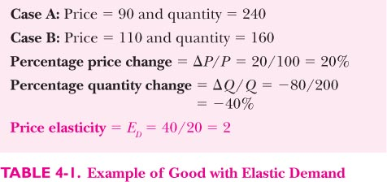
Example of elastic demand
Always ignore the sign of the change!

Slide 8
Computing the Price Elasticity of Demand
Example: If the price of a good increases from Rs 2.00 to Rs 2.20 and the amount you buy falls from 10 to 8 units, then price elasticity of demand is equal to:

Slide 9
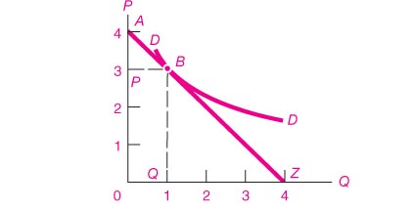
Point Elasticity of demand
η_{d}=│ [dQ/dP]/[P/Q] │

Slide 10
The (Arc) Midpoint Method
The midpoint formula is preferable when calculating the price elasticity of demand over an interval rather than a point on the demand curve. Using the earlier example, the arc elasticity method, price elasticity of demand would be

Slide 11
The Variety of Demand Curves
Perfectly Inelastic demand: Quantity demanded does not respond to price changes. (η_{d}= 0).
Relatively Inelastic Demand
Quantity demanded proportionately less than the change in price (η_{d}< 1).
Unit Elastic Demand Curve (η_{d}= 1).
Relatively Elastic Demand
Quantity demanded proportionately less than the change in price (η_{d}> 1).
Perfectly elastic demand: changes in Quantity demanded tend to infinity to even small changes in price. (η_{d} ∞).

Slide 12
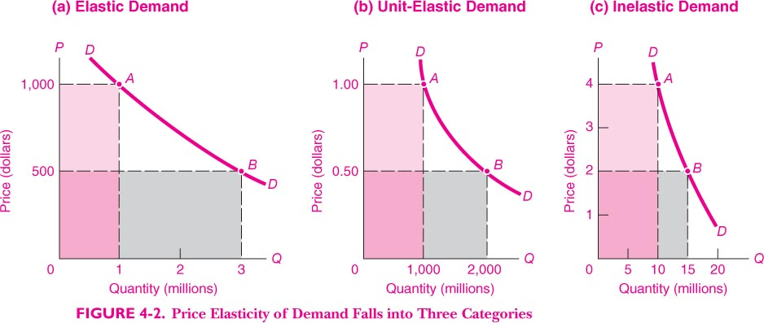
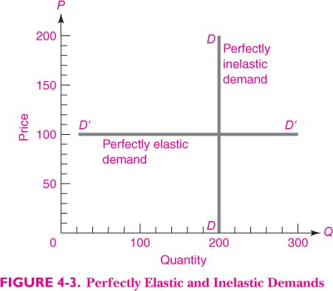
aaa
aaa
aaa
Various types of Demand Curves classified according to elasticity

Slide 13
The Price Elasticity of Demand
(e) Perfectly Elastic Demand: Elasticity Equals Infinity
Price
1. At any price
above Rs 4, quantity
demanded is zero.
$4
Demand
2. At exactly Rs 4,
consumers will
buy any quantity.
0
Quantity
3. At a price below Rs 4,
quantity demanded is infinite.

Slide 14
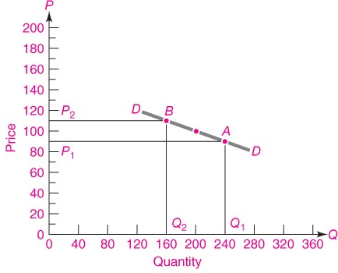
Elastic Demand

Slide 15
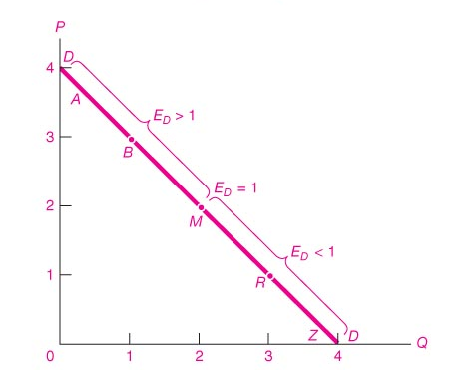
Elasticity of Demand on a linear Demand Curve

Slide 16
Elasticity of a Linear Demand Curve
Demand is elastic; demand is responsive to changes in price.
When price increases from Rs 4 to Rs 5, TR declines from Rs 24 to Rs 20.
Price (Rs)
7
6
Elasticity is > 1 in this range.
5
Elasticity is < 1 in this range.
4
Demand is inelastic; demand is not very responsive to changes in price.
3
2
1
0
2
4
6
8
10
12
14
Quantity
When price increases from Rs 2 to Rs 3, TR increases from RS 20 to Rs 24.

Slide 17
Point Elasticity of demand
η_{d}=│ [dQ/dP]/[P/Q] │

Slide 18
Slope of demand curve vs elasticity
Because the price elasticity of demand measures how much quantity demanded responds to the price, it is closely related to the slope of the demand curve.
But it is not the same thing as the slope!

Slide 19
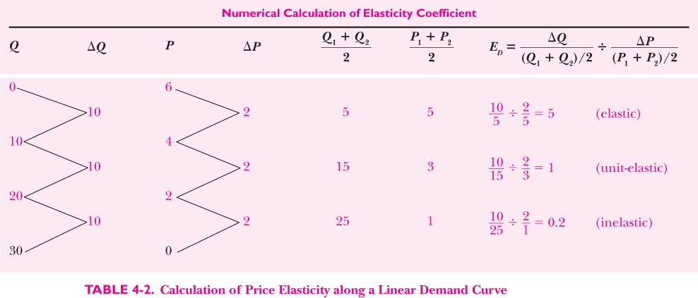

Slide 20
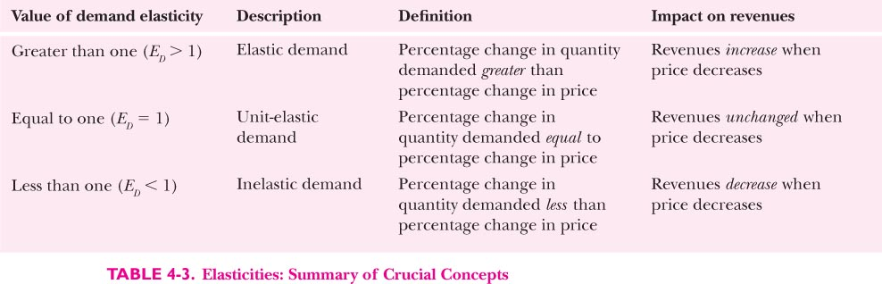

Slide 21
Elasticity of a Linear Demand Curve

Slide 22
Other Demand Elasticities
Income Elasticity of Demand
Income elasticity of demand measures how much the quantity demanded of a good responds to a change in consumers’ income.
It is computed as the percentage change in the quantity demanded divided by the percentage change in income.

Slide 23
Other Demand Elasticities
Computing Income Elasticity
All elasticities are measured by dividing one percentage change by another

Slide 24
Other Demand Elasticities
Income Elasticity
Types of Goods
Normal Goods
Inferior Goods
Higher income raises the quantity demanded for normal goods but lowers the quantity demanded for inferior goods.

Slide 25
Other Demand Elasticities
Income Elasticity
Goods consumers regard as necessities tend to be income inelastic
Examples include food, fuel, clothing, utilities, and medical services.
Goods consumers regard as luxuries tend to be income elastic.
Examples include sports cars, furs, and expensive foods.

Slide 26
Other Demand Elasticities
Cross-price elasticity of demand
A measure of how much the quantity demanded of one good responds to a change in the price of another good, computed as the percentage change in quantity demanded of the first good divided by the percentage change in the price of the second good

Slide 27
THE ELASTICITY OF SUPPLY
Price elasticity of supply is a measure of how much the quantity supplied of a good responds to a change in the price of that good.
Price elasticity of supply is the percentage change in quantity supplied resulting from a percentage change in price.

Slide 28
The Price Elasticity of Supply
(a) Perfectly Inelastic Supply: Elasticity Equals 0
Price
Supply
5
4
1. An
increase
in price . . .
0
100
Quantity
2. . . . leaves the quantity supplied unchanged.

Slide 29
The Price Elasticity of Supply
(b) Inelastic Supply: Elasticity Is Less Than 1
Price
Supply
5
4
1. A 22%
increase
in price . . .
0
100
110
Quantity
2. . . . leads to a 10% increase in quantity supplied.

Slide 30
The Price Elasticity of Supply
(c) Unit Elastic Supply: Elasticity Equals 1
Price
Supply
5
4
(If SUPPLY is unit elastic and linear, it will begin at the origin.)
1. A 22%
increase
in price . . .
0
100
125
Quantity
2. . . . leads to a 22% increase in quantity supplied.

Slide 31
The Price Elasticity of Supply
(d) Elastic Supply: Elasticity Is Greater Than 1
Price
Supply
5
4
1. A 22%
increase
in price . . .
0
100
200
Quantity
2. . . . leads to a 67% increase in quantity supplied.

Slide 32
The Price Elasticity of Supply
(e) Perfectly Elastic Supply: Elasticity Equals Infinity
Price
1. At any price
Above 4, quantity
supplied is infinite.
4
Supply
2. At exactly 4,
producers will
supply any quantity.
0
Quantity
3. At a price below 4,
quantity supplied is zero.

Slide 33
The Price Elasticity of Supply and Its Determinants
Ability of sellers to change the amount of the good they produce.
Beach-front land is inelastic.
Books, cars, or manufactured goods are elastic.
Time period
Supply is more elastic in the long run.

Slide 34
Computing the Price Elasticity of Supply
The price elasticity of supply is computed as the percentage change in the quantity supplied divided by the percentage change in price.

Slide 35
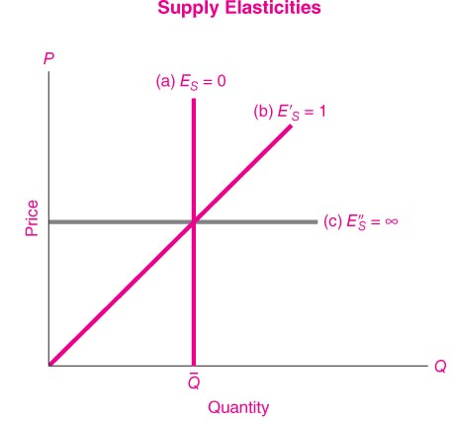

Slide 36
An Increase in Supply in the Market for Wheat
Price of
Wheat
1. When demand is inelastic,
2. . . . leads
an increase in supply
. . .
to a large fall
S₁
in price . . .
S₂
$3
2
Demand
0
100
110
Quantity of
Wheat
3. . . . and a proportionately smaller
increase in quantity sold. As a result,
revenue falls from Rs 300 to Rs 220.

Slide 37
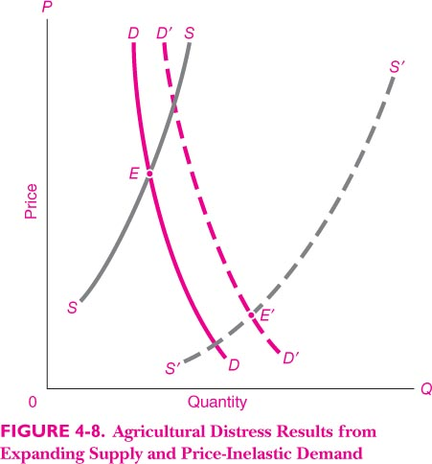
Agricultural distress

Slide 38
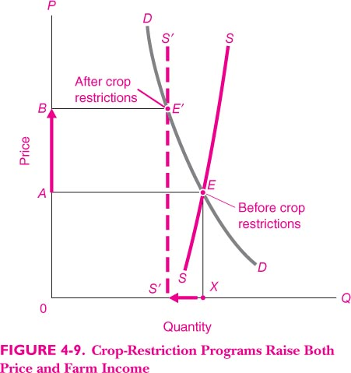
Crop restriction raises both price and farm income

Slide 39
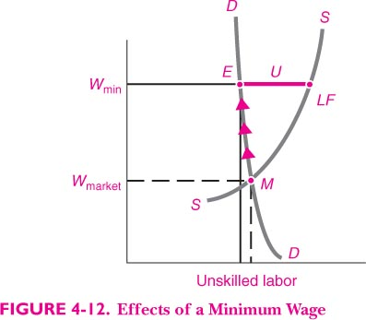
Effect of minimum wage (price Floors)

Slide 40
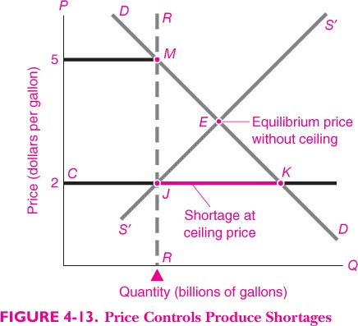
Ceiling prices create shortages and black markets

